Slide 1
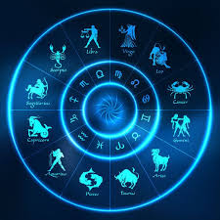

Python Horoscope
“Running the Code From the Stars”
Created by: Joe Healy
Contributions by: Lukavultek

